Slide 1

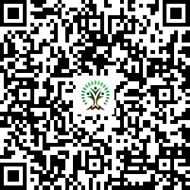


IONIQ Forest
Grid – I Zones 1 -10

Slide 2
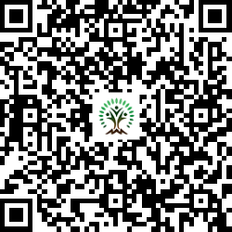
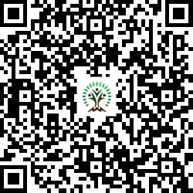
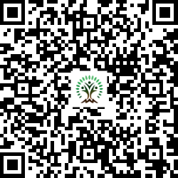
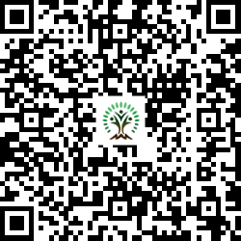
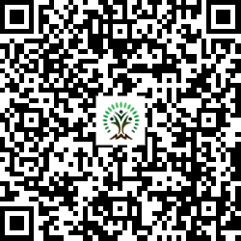
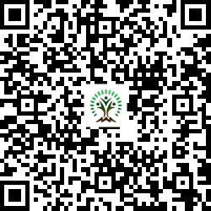
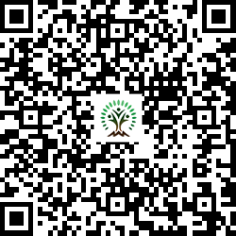
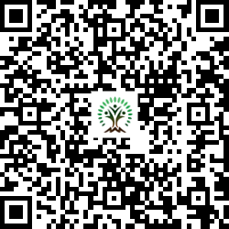
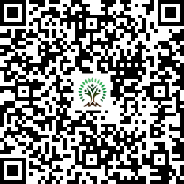
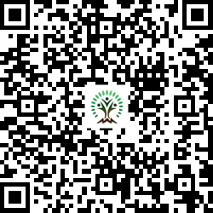
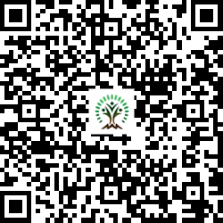
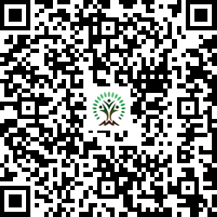
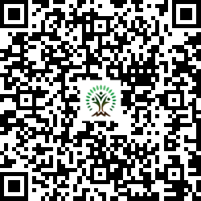
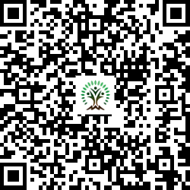
Sr. No. | Scientific Name | Common Name | QR Code
1 | Aegle marmelos | Wood Apple
2 | Alstonia scholaris | Blackboard Tree
3 | Azadirachta indica | Neem Tree
4 | Bauhinia variegata | Kachnar, Orchid Tree
5 | Bombax ceiba | Silk Cotton Tree
6 | Butea monosperma | Flame of the Forest
7 | Cassia fistula | Golden shower tree
Sr. No. | Scientific Name | Common Name | QR Code
8 | Dalbergia sissoo | Indian rosewood
9 | Lagerstroemia speciosa | Pride of India
10 | Melia dubia | Malabar Neem
11 | Mimusops elengi | Spanish cherry
12 | Neolamarckia cadamba | Burrflower tree
13 | Phyllanthus emblica | Indian gooseberry or amla
14 | Pongamia pinnata | Indian Beech Tree

Slide 3
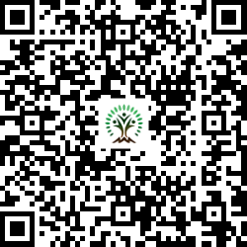
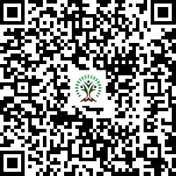
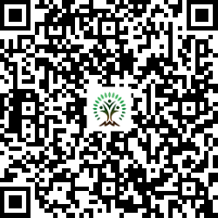
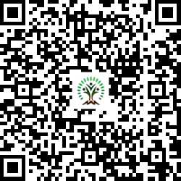
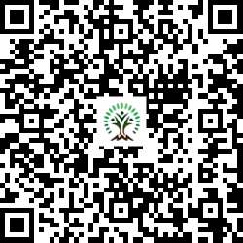
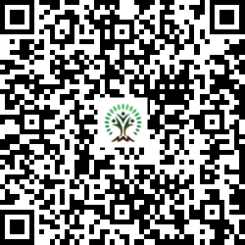
Sr. No. | Scientific Name | Common Name | QR Code
15 | Psidium guajava | Guava
16 | Syzygium cumini | Java plum, Jamun
17 | Tamarindus indica L. | Tamarind
18 | Terminalia arjuna | White Murdah
19 | Terminalia bellirica | Beach almond
20 | Toona ciliata | Indian mahogany

